Slide 1
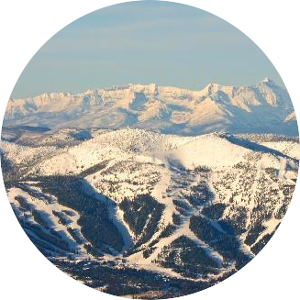
Big Mountain Resort
Daniel Dimond
November 18th, 2023
Big Mountain Resort is looking to better price tickets compared to other resorts in it’s market segment to help determine increase profits by 6% and to offset the $1.54MM operating cost of the new chair lift in the next 12 months.
Notes:
This template can be used as a starter file to give updates for project milestones.
Sections
Right-click on a slide to add sections. Sections can help to organize your slides or facilitate collaboration between multiple authors.
Notes
Use the Notes section for delivery notes or to provide additional details for the audience. View these notes in Presentation View during your presentation.
Keep in mind the font size (important for accessibility, visibility, videotaping, and online production)
Coordinated colors
Pay particular attention to the graphs, charts, and text boxes.
Consider that attendees will print in black and white or grayscale. Run a test print to make sure your colors work when printed in pure black and white and grayscale.
Graphics, tables, and graphs
Keep it simple: If possible, use consistent, non-distracting styles and colors.
Label all graphs and tables.

Slide 2
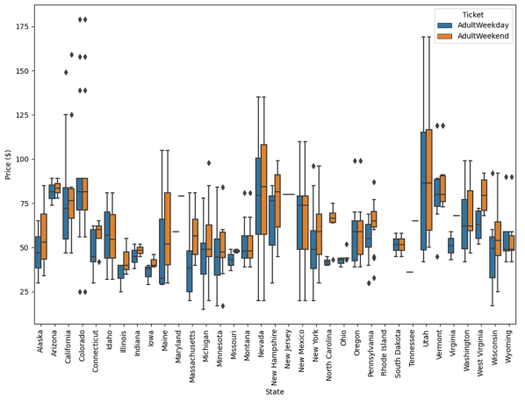
Options to increase revenue
Permanently closing down up to 10 of the least used runs.
Add a run, increasing the vertical drop by 150 feet, and installing an additional chair lift.
Repeat #2 but with the addition of 2 acres of snow making.
Increasing the longest run by .2 miles and guaranteeing its snow coverage by adding 4 acres of snow making capability.
Notes:
What is the project about?
Define the goal of this project
Is it similar to projects in the past or is it a new effort?
Define the scope of this project
Is it an independent project or is it related to other projects?
* Note that this slide is not necessary for weekly status meetings

Slide 3
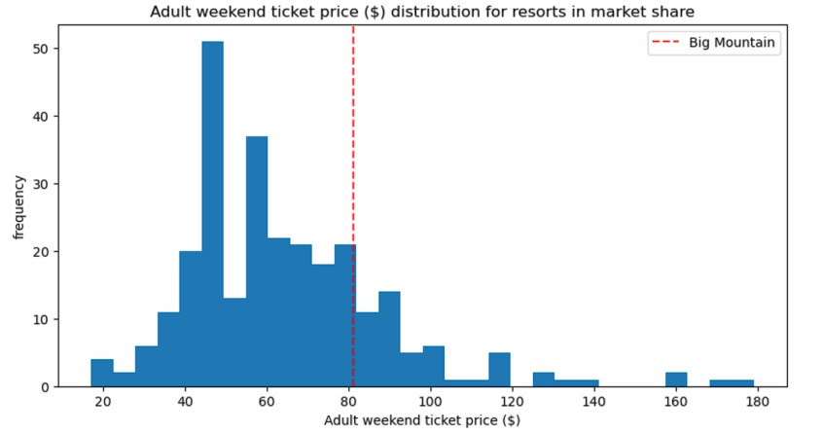
Current ticket price distribution
Notes:
Duplicate this slide as necessary if there is more than one issue.
This and related slides can be moved to the appendix or hidden if necessary.

Slide 4
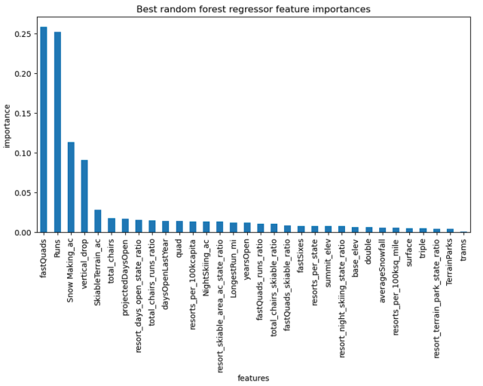
Modeling results – Features of Importance

Slide 5
Modeling results
Permanently closing down up to 10 of the least used runs.
The model shows closing one run makes no difference.
Closing 2 and 3 successively reduces support for ticket price and so revenue.
Closing down 3 runs, may as well close down 4 or 5 as there's no further loss in ticket price.
Increasing the closures down to 6 or more leads to a large drop in revenue.
Some additional data might be needed to further explore these options.
Add a run, increasing the vertical drop by 150 feet, and installing an additional chair lift.
This scenario increases support for ticket price by $1.99.
Over the season, this could be expected to amount to $3,474,638 additional revenue.
Repeat #2 but with the addition of 2 acres of snow making.
Such a small increase in the snow making area makes no difference according to our model!
Increasing the longest run by .2 miles and guaranteeing its snow coverage by adding 4 acres of snow making capability.
The model predicts no difference whatsoever.
The longest run feature was significant in the linear regression model.
The random forest model (the one we chose because of its better performance) has the longest run further down in the feature importance list.
Notes:
* If any of these issues caused a schedule delay or need to be discussed further, include details in next slide.

Slide 6
Recommendations
Currently the weekend ticket price for Big Mountain is $81. According to the important facilities of Big Mountain (Big Mountain scored high) and other resorts, ticket prices could increase as much as $14.87. There is a margin of error of $10.39 but still suggests an increase of $4.48 is viable.
Based on the 4 scenario model results, scenario 2 seems to yield the best results for overall profitability.
Closing down the least used run will save operating cost and have little to no impact on ticket price.
This model was saved for use with changing parameters to help analysts maintain further predictions in the coming years based on new data.

